Slide 1
Stack

Slide 2

Stack

Slide 3
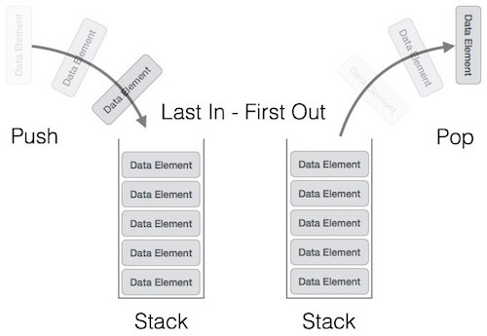
Stack Representation

Slide 4
Basic Operations
push() − Pushing (storing) an element onto the stack.
pop() − Removing (accessing) an element from the stack.
Traverse()-Visit elements of data structure.

Slide 5
Functionality of Stack
peek( ) − get the top data element of the stack, without removing it.
isFull( ) − check if stack is full.
isEmpty( ) − check if stack is empty.

Slide 6
Algorithms
peek()
begin procedure peek
return stack[top]
end procedure.
Example
int peek() {
return stack[top];
}

Slide 7
isfull()
begin procedure isfull
if top equals to MAXSIZE
return true
else
return false
endif
end procedure
Example
bool isfull() {
if(top == MAXSIZE)
return true;
else
return false;
}

Slide 8
isempty()
begin procedure isempty
if top less than 1
return true
else
return false
endif
end procedure
bool isempty() {
if(top == -1)
return true;
else
return false;
}

